Slide 1

Innovative Programming:
Ensuring All Students
Have a Plan
Amy Schakat
Coordinator of Career Technical Education
South-Western City School District

Slide 2
Think Big Picture
Jaime Casap, Chief Education Evangelist at Google
What problem to do you want to solve?
Take 2 minutes to write this problem down.

Slide 3
SWCSD problem:
Our students are graduating from high school without a plan.

Slide 4
Vision Meets Action
Take 3 minutes to write down your vision for your district, company or region.
Now think of it in terms of the problem you want to solve.
How can programming solve that problem?

Slide 5

What are we missing in programs, options, courses and experiences?

Slide 6
Know Your Options
Know Courses - ODE
Know Credentials
Know Business Needs
Know Laws and Funding Rules
Know Post-Secondary Pathways
Know your Staff

Slide 7
Act!!!
Yes And… not Yes But
Don't wait until you have everything figured out to move
Belief vs Behavior
Support, Professional Development and Accountability
Invest in people

Slide 8
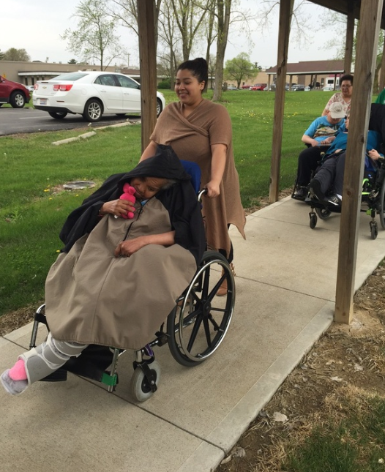
Examples
C3PO
Customer Service/ CNM
Career Development
Fire Science
Cyber Security
Notes:
Photo reference: Reference: Ohio Provider Resource Association. (n.d.). Retrieved October 18, 2016, from https://www.opra.org/updates/building-the-next-generation-of-caregivers/

Slide 9
THANKS!
Any questions?
Amy Schakat
amy.schakat@swcsd.us

